Slide 1

Machine Learning: Regularization
Addressing Overfitting & Complexity

Slide 2


Introduction to Regularization
What it is
The Core Objective
Regularization is a technique used to calibrate machine learning models to minimize the adjusted loss function and prevent overfitting.
The goal is to solve the Bias-Variance Trade-off. By adding a small amount of bias, we significantly reduce the variance of the model on unseen data.
It adds a penalty term to the cost function to discourage overly complex models by shrinking the magnitude of the coefficients.
•
Prevents high coefficients
•
Simplifies the model
•
Improves generalization

Slide 3


Ridge Regression (L2 Regularization)
What it is
L2 Loss Formula:
Ridge regression addresses overfitting by adding a penalty proportional to the square of the magnitude of coefficients (L2 penalty).
Breakdown: - First term: Ordinary Least Squares (Residual Sum of Squares). - : Tuning parameter (regularization strength). - : L2 penalty (squared coefficients).
It "shrinks" coefficients towards zero but never makes them exactly zero.

Slide 4


Ridge Usage & Sensitivity
When to Use
Sensitivity
Use when most features contribute slightly to the output.
Ridge regression is sensitive to the scaling of input features. Since it uses squared coefficients, features with larger scales will be penalized more heavily than those with smaller scales.
Best when independent variables are highly correlated (Multicollinearity).
Note: Always perform Feature Scaling (Standardization) before applying Ridge.
Effective when (more features than samples).

Slide 5

Lasso Regression (L1 Regularization)
What it is
L1 Loss Formula:
Lasso (Least Absolute Shrinkage and Selection Operator) adds a penalty equal to the absolute value of coefficients (L1 penalty).
It can force coefficients to exactly zero, effectively acting as a feature selection method.
Breakdown: - First term: Residual Sum of Squares (Error). - : Regularization strength. - : L1 penalty (absolute values).

Slide 6



Lasso Selection & Sensitivity
Feature Selection
When to Use
Lasso is unique because it creates sparse models. If a feature is not important, its coefficient is reduced to zero.
Use when you suspect only a small subset of features is useful.
This provides an automated way to perform variable selection, simplifying the model significantly.
Excellent for automatic variable reduction.
Sensitivity
Lasso is highly sensitive to multicollinearity. If two features are highly correlated, Lasso tends to pick one arbitrarily and zero out the other, which can lead to unstable model interpretations.

Slide 7



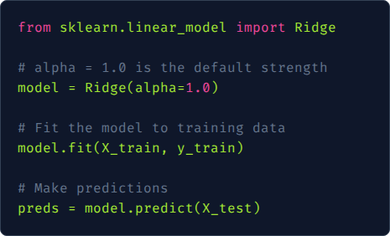
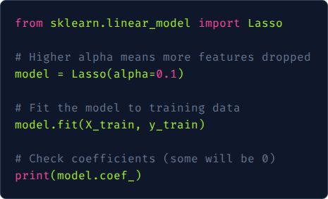
Implementing Regularization
Ridge in Python
Lasso in Python
Using Scikit-Learn to apply L2 regularization:
Using Scikit-Learn to apply L1 regularization:

Slide 8

Elastic Net (L1 + L2 Combination)
What it is
Elastic Net Loss Formula:
Elastic Net is a hybrid regularization technique that combines both L1 (Lasso) and L2 (Ridge) penalties.
Formula Breakdown: - : Controls L1 (Lasso) penalty component. - : Controls L2 (Ridge) penalty component. - Often implemented with a single and an L1 Ratio (mix parameter).
It aims to retain the feature selection property of Lasso while adding the stability and grouping effect of Ridge.

Slide 9
ElasticNet Usage & Sensitivity
When to Use
Sensitivity
Use when there are multiple correlated features.
Sensitive to the L1 Ratio. If ratio = 1, it behaves as Lasso; if ratio = 0, it behaves as Ridge.
When feature selection is needed but Lasso is too unstable.
It overcomes Lasso’s limitation of picking features randomly among highly correlated variables by grouping them and keeping them together.
Default choice when you have no prior knowledge of feature importance.

Slide 10
Tuning Hyperparameter Alpha (α)
Finding the Optimal α
The parameter α (sometimes denoted as λ) controls the tradeoff between fitting the training data and keeping the coefficients small.
α
α = 0: Equivalent to OLS (No regularization).
The Tuning Parameter
α → ∞: Coefficients approach 0 (Underfitting).
Best Practice: Use Cross-Validation (e.g., GridSearchCV) to find the α that minimizes validation error.

Slide 11
Comparison of Techniques
Feature | Ridge (L2) | Lasso (L1) | ElasticNet
Penalty Term | Squared Magnitude | Absolute Magnitude | Combination of Both
Coefficient Zero? | Never (Only tiny) | Yes (Sparse models) | Yes
Feature Selection | No | Yes (Built-in) | Yes
Best Case | Multicollinearity | Sparse Features | Correlated Features

Slide 12





Summary & Best Practices
Standardize First
Cross-Validate
Select Wisely
Always scale your data before applying regularization to ensure penalties are applied fairly.
Never pick alpha arbitrarily. Use K-Fold Cross-Validation to optimize the penalty strength.
Start with ElasticNet if you have many correlated features or use Ridge if features are all likely relevant.

Slide 13
Q & A
Deep Dive into Regularization Techniques
Machine Learning Course | Section: Model Optimization

